Slide 1




The Nature of Art
Approaches
Genius
Kant
Lichtenstein
Definitional
Classificatory
Evaluative
Philosophy
Context
Versions
Beauty
Taste
Hume;
Age
Gender
Social Status
Race
Social Factors
What do you think?

Slide 2




Beautiful things (?)
=

Slide 3
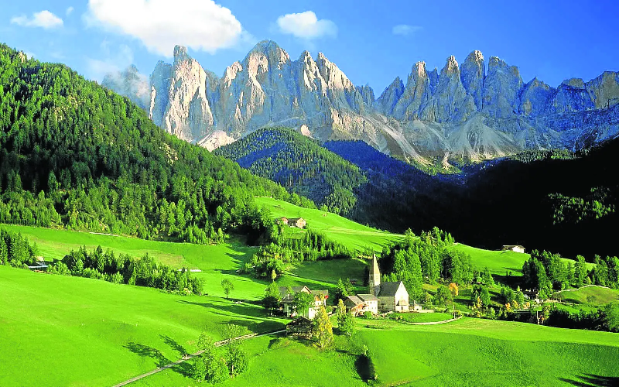
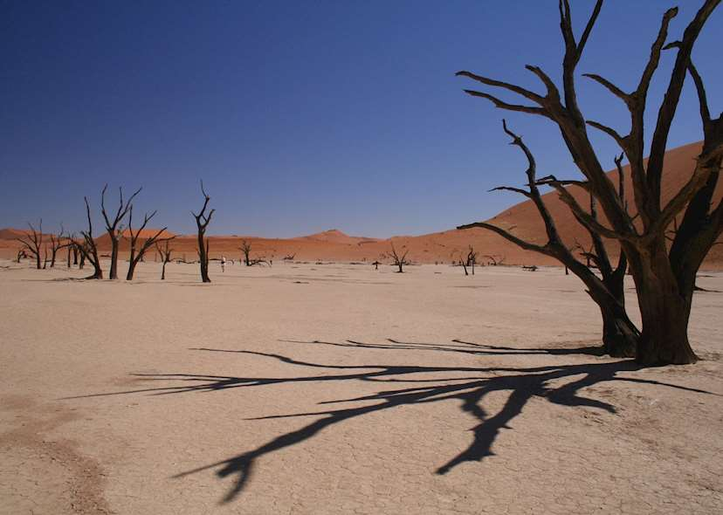
Aesthetics
Of nature (landscapes, body, natural sciences)
Of human creation (art objects, conceptual objects)

Slide 4
Sublime
Power to transform the ‘ugly’ into virtue (a version of Schiller’s sublime

Slide 5

Fine Art
painting, sculpture , architecture, music, and literature

Slide 6
Give a situation where there is blending of two art forms. Explain.

Slide 7
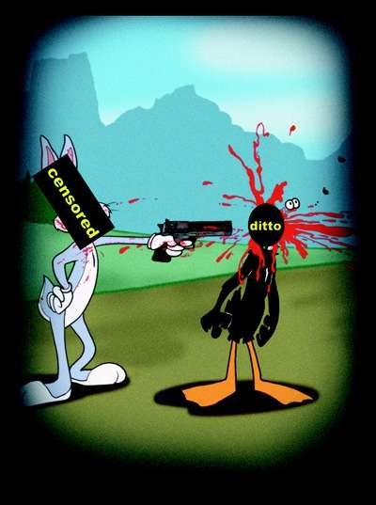

Ethicism vs. Aestheticism

Slide 8
Irrational Pleasure
Listening to sad music
Is it appropriate?
Expected reaction (requisite)

